Slide 1
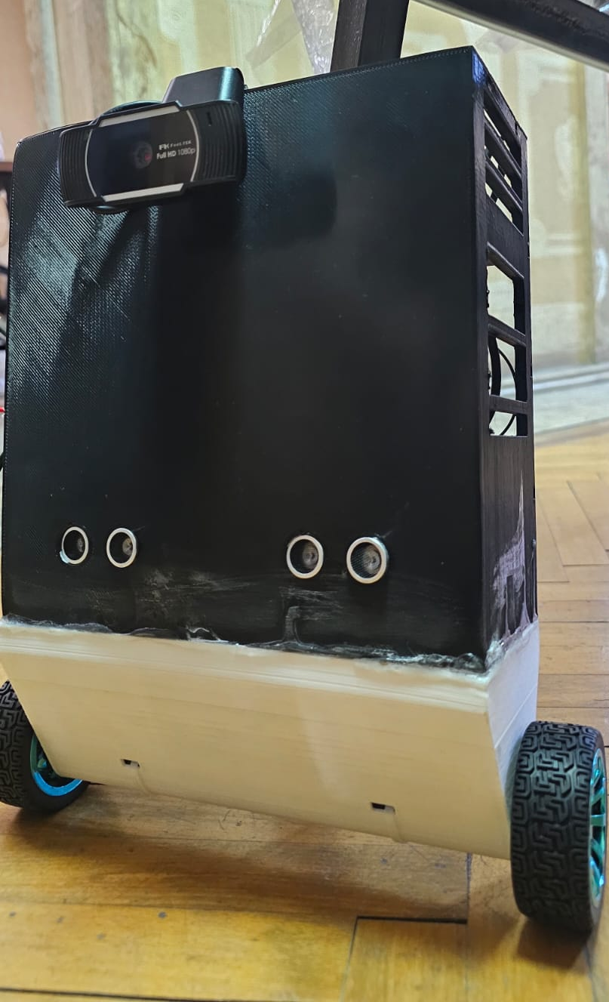
Surveillance Automobile
Advanced Networks
Youssef eslam hussein || 231000070
belal tamer || 231001148
yousef hesham ahmed || 231010735
yousef khaled hashem || 231000337
Adham Sewelam ||

Slide 2
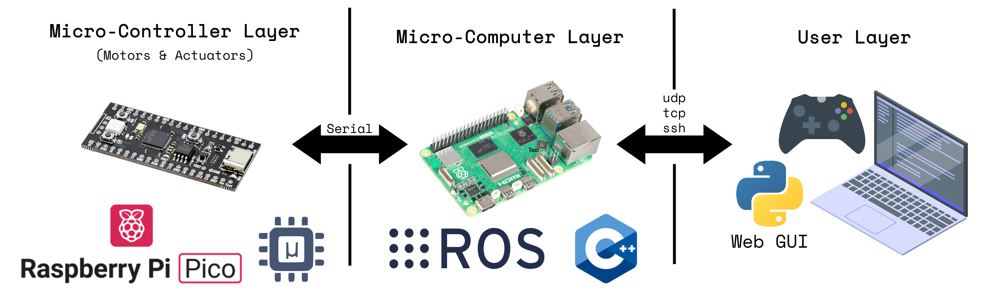
What is EVE?
EVE is a Surveillance Automobile
- All
- EVE

Slide 3
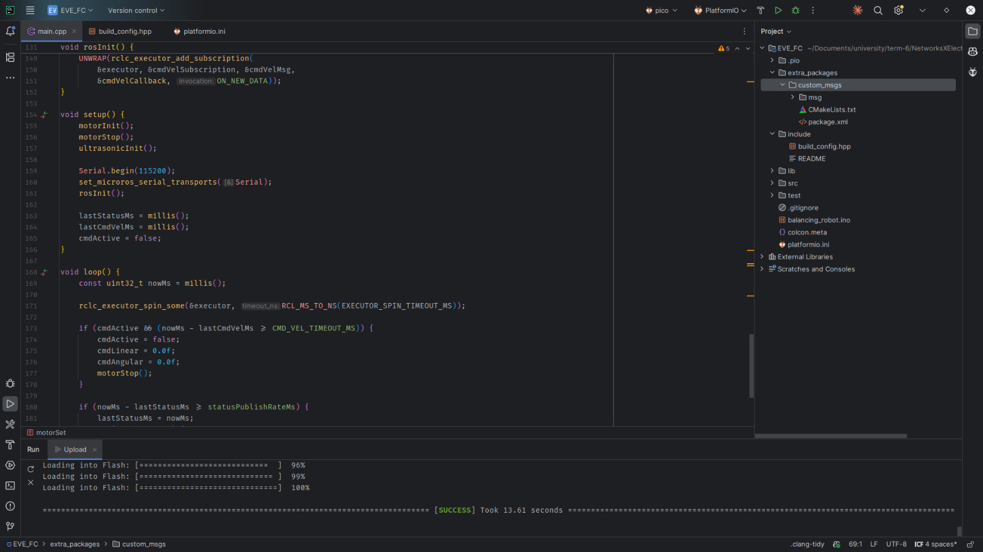
software
-Youssef Khalid
- hardware

Slide 4
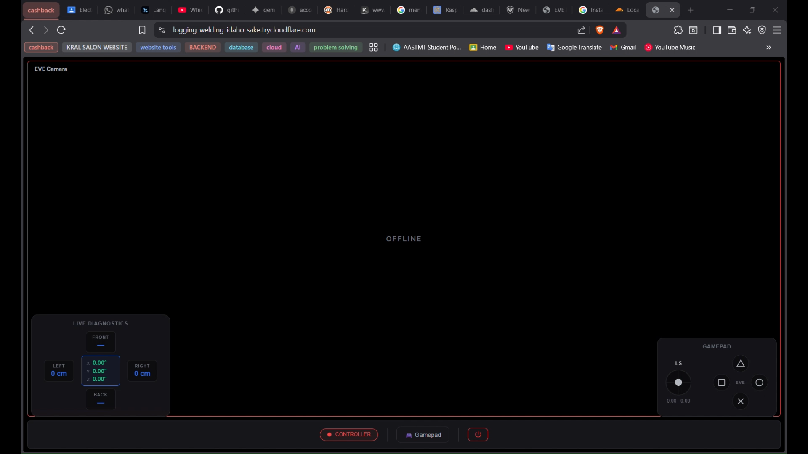
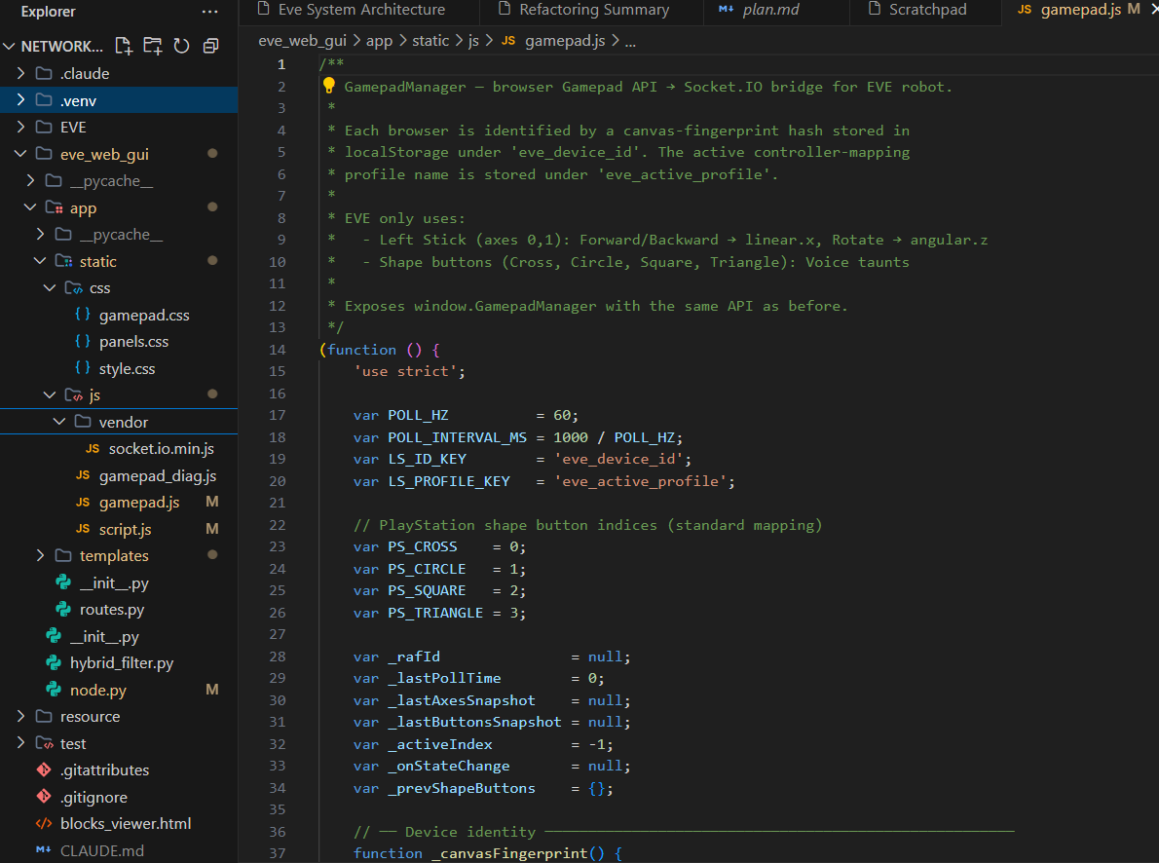
THE GUI.
USER DASHBOARD SHOWS THE CONTROLLER DATA
-Youssef ESLAM HUSSEIN
- GUI

Slide 5
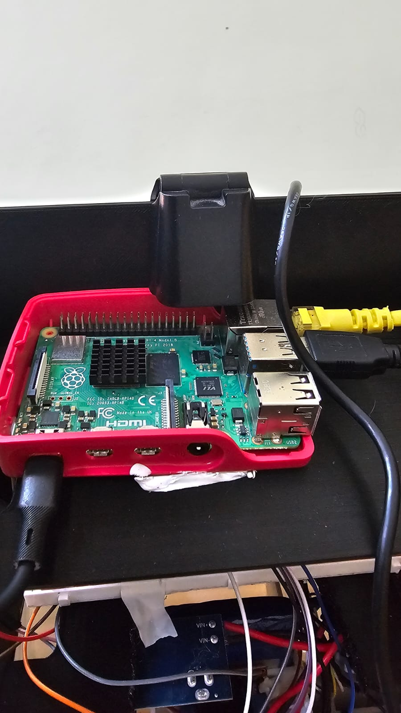
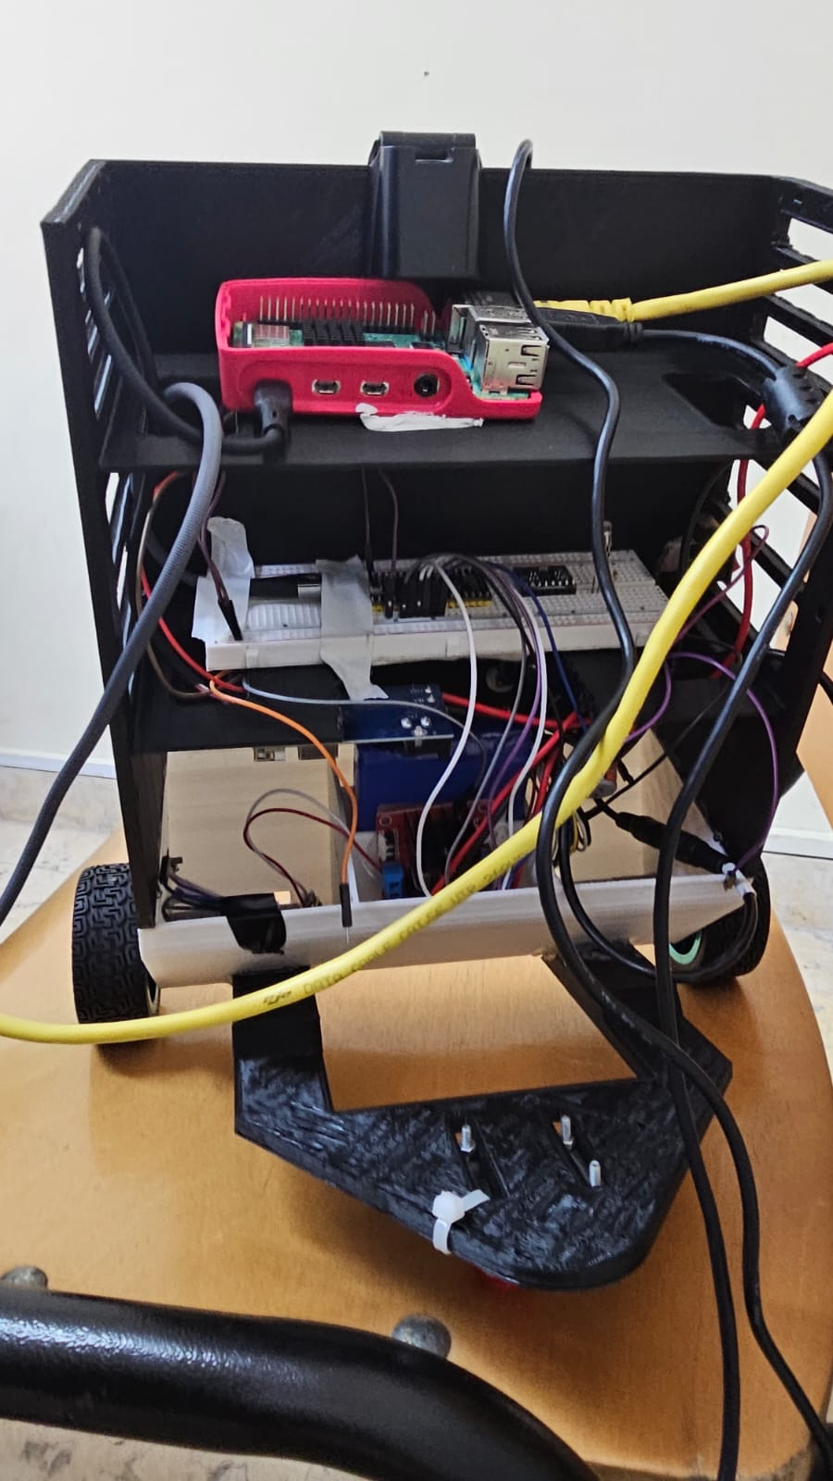
HARDWARE.
The hardware components of the robot:
Raspberry Pi 4
USB Camera
h bridge
2 ultrasonic sensors
2 motors + 2 wheels
MEMS IMU
raspberry pi pico
DC TO DC CONVERTER
battery 12v
-belal TAMER
- hardware

Slide 6
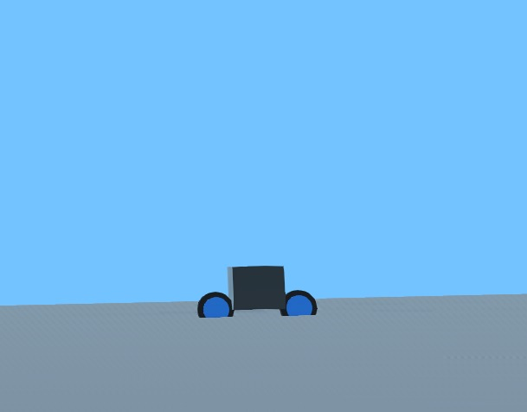
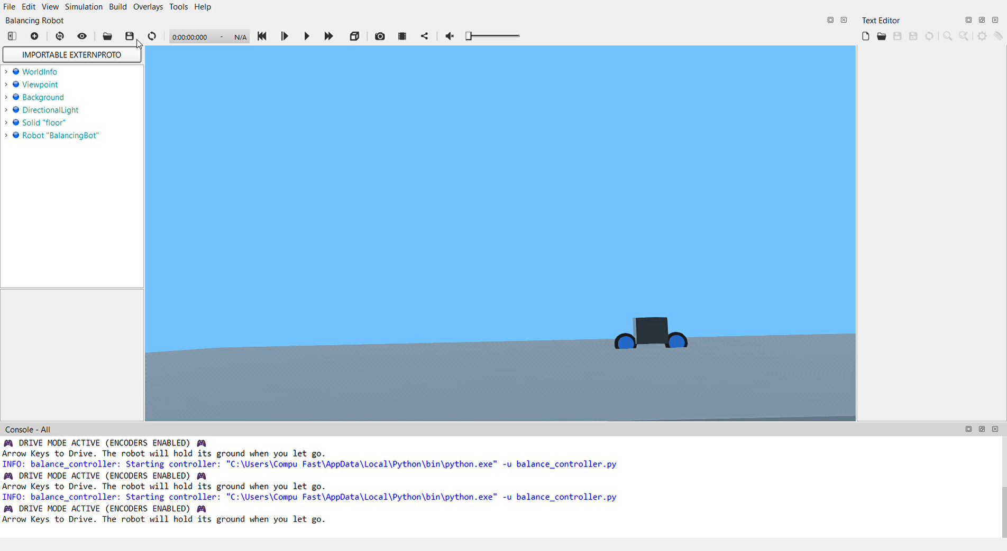
THE SIMULATION.
Why simulation?
-Youssef Moussa & Adham Sewelam
- simulation

